Slide 1
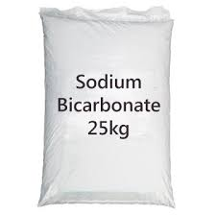
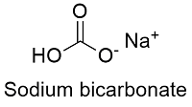

Y_1422
Sodium Bicarbonate Production from Soda Ash.
Baking Soda Manufacturing Business
www.entrepreneurindia.co

Slide 2
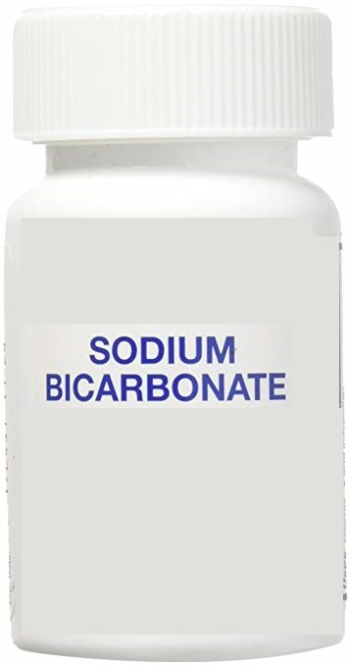
Introduction
Sodium Bicarbonate is an odorless and alkaline compound with the chemical formula NaHCO3. Sodium bicarbonate is commonly referred to as baking soda, which is a popular food ingredient, medicine, and household product. Sodium bicarbonate is mostly used in the food and beverage industry in the preparation of an extensive range of food products such as cakes, pancakes, rolls, muffins, cookies, soda bread, breads, sports drinks, soft drinks, and other baked and fried foods.
www.entrepreneurindia.co

Slide 3
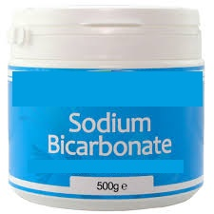
It is mainly used as an effervescent agent in food and beverage products. Sodium bicarbonate is a leavening agent, which is commonly used for dough rise. Sodium bicarbonate is an antacid used to relieve heartburn and acid indigestion. This is because it has leavening properties, meaning it causes dough to rise by producing carbon dioxide. Aside from cooking, baking soda has a variety of additional household uses and health benefits.
www.entrepreneurindia.co

Slide 4
Sodium bicarbonate is commonly used as baking soda in food and beverage and animal feed. High consumption of grains, dairy, sugar, meat and fish products increases the body acid level which results into several health problems. Consumption of baking soda which is commonly used term for sodium bicarbonate in food & beverage industry, neutralizes the acidic level of body and reduces the risk of several diseases such as arthritis, digestive disorder, heartburn and stomach upset. Application of sodium bicarbonate in wide range of products such as dairy, beers, ciders, cereals, noodles, confectioners, pretzels, etc. will drive the market. Further its excellent properties such as enhancing cakes volume, will positively influence the global sodium bicarbonate market.
www.entrepreneurindia.co

Slide 5
Uses and Applications of Sodium Bicarbonate:
Sodium bicarbonate can be used to remove the odor that a thermos takes on after not being used for a long time with the lid closed. It can also be used as a deodorant when applied under the arms. To make things white, mix sodium bicarbonate with lavender essential oil.
Sodium Bicarbonate in Pest Control
Sodium bicarbonate as a cleanser
Sodium bicarbonate in cosmetic
Sodium bicarbonate as a neutralizer
Sodium bicarbonate for domestic purposes
Sodium bicarbonate in gastronomy
www.entrepreneurindia.co

Slide 6
Market Outlook
The global sodium bicarbonate market is estimated to reach US$ 2,443.1 Mn by the end of the forecast period and is expected to expand at a CAGR of 3.7% for the period 2018–2028. The factors responsible for this positive growth of sodium bicarbonate market are increasing demand from industrial and pharmaceutical sectors, growing disposable income and favorable socioeconomic trends.
Global demand for sodium bicarbonate will be driven by increasing demand from food & beverage industry. Rising population worldwide is growing the demand for sodium bicarbonate coupled with shift in consumer eating habits, favoring the sodium bicarbonate market.
www.entrepreneurindia.co

Slide 7
Consumption of dairy, meat, fish etc. have predominantly resulted into higher body PH value, to treat alkaline level of human body sodium bicarbonate is used. Further its application in bakery product will positively impact sodium bicarbonate market growth over coming years.
www.entrepreneurindia.co

Slide 8
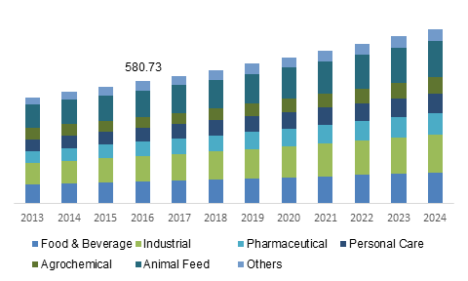
U.S. Sodium Bicarbonate Market Size, By End-User, 2013 - 2024 (USD Million)
www.entrepreneurindia.co

Slide 9
The increasing consumption in the food industry and growing demand from the personal care industry is driving the market growth. On the flip side, health hazards regarding the consumption of sodium bicarbonate as well as rising competition in the market are expected to limit market growth. Whereas, the growing use of baking soda as a deodorizing agent in personal care products is expected to create potential opportunity over the forecast period.
The increasing consumption in the food industry and growing demand from the personal care industry is driving the market growth. On the flip side, health hazards regarding the consumption of sodium bicarbonate as well as rising competition in the market are expected to limit market growth.
www.entrepreneurindia.co

Slide 10
Whereas, the growing use of baking soda as a deodorizing agent in personal care products is expected to create potential opportunity over the forecast period.
It has a multitude of uses from everyday goods to pharmaceuticals and beyond. Different grades of sodium bicarbonate that currently available in market. This is primarily to differentiate the usability of the product based on its grade in Food & Beverages, pharmaceutical, and feed. Sodium bicarbonate is primarily used in baking as a leavening agent. Some of its applications in Food & Beverages include chemical leavening agent in ready-to-eat cakes and pastries, odor absorbent, fruit washing agent and cleaning agent.
www.entrepreneurindia.co

Slide 11
The versatile uses of sodium bicarbonate as an active pharmaceutical ingredient and excipient has elevated the global market positioning of the salt in terms of both demand and adoption. A recent study reveals that treatments incorporating sodium bicarbonate are effective in bringing about improvements in the endothelial function in patients suffering from stage 3 and stage 4 chronic kidney disease. Wider applications of sodium bicarbonate will boost revenues in the global market.
The popularity of starch, powdered sugar, and common salt has directly influenced the growth prospects of the global market for sodium bicarbonate. Furthermore, the sale of sodium bicarbonate through several new departmental store chains has also created tremendous growth opportunities within the global market for this product.
www.entrepreneurindia.co

Slide 12
Another key factor that is prognosticated to propel market demand in the forthcoming years is the emergence of new vendors in the global market for sodium bicarbonate.
The global sodium bicarbonate market is hindered by complication and side effect on the consumption. High consumption of this products for longer period can cause severe health problem such as allergic reactions, arthritics and breathing problem. Further there are certain restriction on sodium bicarbonate on its application in food and medical items which will negatively influence the market growth by 2024.
www.entrepreneurindia.co

Slide 13
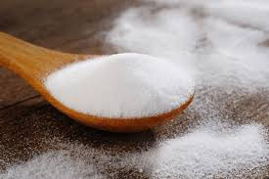
Increasing growth in industrial sector and population and demographic changes are the prime factors responsible for the positive growth of the sodium bicarbonate market across the globe. The extension of government health programs in developing countries is also expected to have a positive impact on the growth of the sodium bicarbonate market during the forecast period.
In terms of industrial growth, the flue gas desulphurization industry is experiencing positive growth and is expected to continue to experience the same in the coming years as well.
www.entrepreneurindia.co

Slide 14
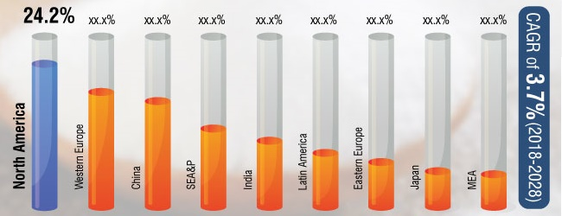
Global Sodium Bicarbonate Market Value Share (%), By Region (2018)
www.entrepreneurindia.co

Slide 15
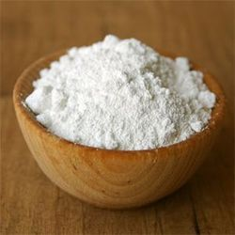
Crystal/powdered crystal product segment held the highest sodium bicarbonate market share in terms of revenue. It is majorly used in various food products and agrochemical items. Increasing consumption of sodium bicarbonate in food & beverage and agrochemical industry is augmenting the demand for Crystal/powdered crystal product segment. Further major consumption of sodium bicarbonate is done in crystal/powdered crystal which is growing the market by CAGR of over 5.5% in forecast period.
www.entrepreneurindia.co

Slide 16
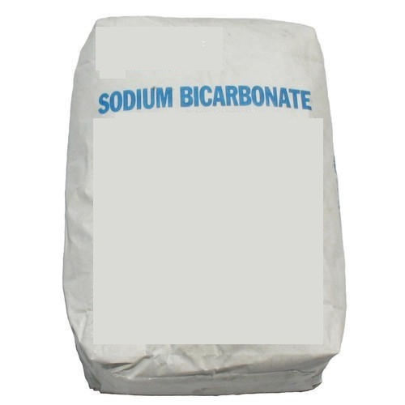
Some of the key vendors in the global sodium bicarbonate market are Solvay Specialty Polymers USA, LLC, Tosoh Corporation, Natural Soda, LLC, Crystal Mark, Inc., and Blastrite, Tata Chemical Ltd., Solvay, KAZAN SODA ELEKTRIK, CIECH Group, Sisecam Group, Tosoh Corporation, Bashkir Soda Company, Novacap, Church & Dwight Co., Inc., NATURAL SODA LLC and AGC Inc.
www.entrepreneurindia.co

Slide 17
Major Queries/Questions Answered in the Report?
What is Sodium Bicarbonate Manufacturing industry ?
How has the Sodium Bicarbonate Manufacturing industry performed so far and how will it perform in the coming years ?
What is the Project Feasibility of Sodium Bicarbonate Manufacturing Plant ?
What are the requirements of Working Capital for setting up Sodium Bicarbonate Manufacturing plant ?
www.entrepreneurindia.co

Slide 18
5. What is the structure of the Sodium Bicarbonate Manufacturing Business and who are the key/major players ?
What is the total project cost for setting up Sodium Bicarbonate Manufacturing Business?
What are the operating costs for setting up Sodium Bicarbonate Manufacturing plant ?
What are the machinery and equipment requirements for setting up Sodium Bicarbonate Manufacturing plant ?
www.entrepreneurindia.co

Slide 19
Who are the Suppliers and Manufacturers of Plant & Machinery for setting up Sodium Bicarbonate Manufacturing plant ?
10. What are the requirements of raw material for
setting up Sodium Bicarbonate Manufacturing plant ?
Who are the Suppliers and Manufacturers of Raw materials for setting up Sodium Bicarbonate Manufacturing Business?
What is the Manufacturing Process of Sodium Bicarbonate?
www.entrepreneurindia.co

Slide 20
What is the total size of land required for setting up Sodium Bicarbonate Manufacturing plant ?
14. What will be the income and expenditures for Sodium Bicarbonate Manufacturing Business?
What are the Projected Balance Sheets of Sodium Bicarbonate Manufacturing plant ?
What are the requirement of utilities and overheads for setting up Sodium Bicarbonate Manufacturing plant?
What is the Built up Area Requirement and cost for setting up Sodium Bicarbonate Manufacturing Business?
www.entepreneurindia.co

Slide 21
What are the Personnel (Manpower) Requirements for setting up Sodium Bicarbonate Manufacturing Business?
What are Statistics of Import & Export for Sodium Bicarbonate?
20. What is the time required to break-even of Sodium Bicarbonate Manufacturing Business?
What is the Break-Even Analysis of Sodium Bicarbonate Manufacturing plant?
What are the Project financials of Sodium Bicarbonate Manufacturing Business?
www.entepreneurindia.co

Slide 22
What are the Profitability Ratios of Sodium Bicarbonate Manufacturing Project?
24. What is the Sensitivity Analysis-Price/Volume of
Sodium Bicarbonate Manufacturing plant?
25. What are the Projected Pay-Back Period and
IRR of Sodium Bicarbonate Manufacturing plant?
What is the Process Flow Sheet Diagram of Sodium Bicarbonate Manufacturing project?
www.entrepreneurindia.co

Slide 23
What are the Market Opportunities for setting
up Sodium Bicarbonate Manufacturing plant?
What is the Market Study and Assessment for
setting up Sodium Bicarbonate Manufacturing Business?
What is the Plant Layout for setting up Sodium Bicarbonate Manufacturing Business?
www.entrepreneurindia.co

Slide 24
Table of Contents
of the
Project Report
www.entrepreneurindia.co

Slide 25
Our Detailed Project Report contains
Introduction
Properties
Uses & Applications
List of Plant & Machineries
Miscellaneous Items and Accessories
Instruments, Laboratory Equipments and Accessories
Electrification, Electric Load and Water
Maintenance, Suppliers/Manufacturers of Plant and Machineries
www.entrepreneurindia.co

Slide 26
Process of Manufacture
Flow Sheet Diagram
List of Raw Materials
Availability of Raw Materials
Requirement of Staff & Labour
Skilled & Unskilled Labour
Requirement of Land Area
Built up Area
Plant Layout
www.entrepreneurindia.co

Slide 27
Project Financials
• Project at a Glance Annexure
• Assumptions for Profitability workings ………………………..1
• Plant Economics…………………………………………………..2
• Production Schedule………………………………………………3
• Land & Building……………………………………………….……4
Factory Land & Building
Site Development Expenses
www.entrepreneurindia.co

Slide 28
• Plant & Machinery……………………………………………..……..5
Indigenous Machineries
Other Machineries (Miscellaneous, Laboratory etc.)
• Other Fixed Assets………………………………………..........….......6
Furniture & Fixtures
Pre-operative and Preliminary Expenses
Technical Knowhow
Provision of Contingencies
• Working Capital Requirement Per Month……………………….…7
Raw Material
Packing Material
Lab & ETP Chemical Cost
Consumable Store
www.entrepreneurindia.co

Slide 29
• Overheads Required Per Month and Per Annum………….…….…8
Utilities & Overheads (Power, Water and Fuel Expenses etc.)
Royalty and Other Charges
Selling and Distribution Expenses
• Salary and Wages …………………………………………....……..9
• Turnover Per Annum ……………………………………….....…10
• Share Capital…………………………………………………….....11
Equity Capital
Preference Share Capital
www.entrepreneurindia.co

Slide 30
• Annexure 1 :: Cost of Project and Means of Finance
• Annexure 2 :: Profitability and Net Cash Accruals
Revenue/Income/Realisation
Expenses/Cost of Products/Services/Items
Gross Profit
Financial Charges
Total Cost of Sales
Net Profit After Taxes
Net Cash Accruals
www.entrepreneurindia.co

Slide 31
• Annexure 3 :: Assessment of Working Capital requirements
Current Assets
Gross Working Capital
Current Liabilities
Net Working Capital
Working Note for Calculation of Work-in-process
• Annexure 4 :: Sources and Disposition of Funds

Slide 32
• Annexure 5 :: Projected Balance Sheets
ROI (Average of Fixed Assets)
RONW (Average of Share Capital)
ROI (Average of Total Assets)
• Annexure 6 :: Profitability Ratios
D.S.C.R
Earnings Per Share (EPS)
Debt Equity Ratio
www.entrepreneurindia.co

Slide 33
• Annexure 7 :: Break-Even Analysis
Variable Cost & Expenses
Semi-Variable/Semi-Fixed Expenses
Profit Volume Ratio (PVR)
Fixed Expenses / Cost
B.E.P
www.entrepreneurindia.co

Slide 34
• Annexure 8 to 11 :: Sensitivity Analysis-Price/Volume
Resultant N.P.B.T
Resultant D.S.C.R
Resultant PV Ratio
Resultant DER
Resultant ROI
Resultant BEP
www.entrepreneurindia.co

Slide 35
• Annexure 12 :: Shareholding Pattern and Stake Status
Equity Capital
Preference Share Capital
• Annexure 13 :: Quantitative Details-Output/Sales/Stocks
Determined Capacity P.A of Products/Services
Achievable Efficiency/Yield % of Products/Services/Items
Net Usable Load/Capacity of Products/Services/Items
Expected Sales/ Revenue/ Income of Products/ Services/ Items
www.entrepreneurindia.co

Slide 36
• Annexure 14 :: Product wise Domestic Sales Realisation
• Annexure 15 :: Total Raw Material Cost
• Annexure 16 :: Raw Material Cost per unit
• Annexure 17 :: Total Lab & ETP Chemical Cost
• Annexure 18 :: Consumables, Store etc. • Annexure 19 :: Packing Material Cost
• Annexure 20 :: Packing Material Cost Per Unit
www.entrepreneurindia.co

Slide 37
• Annexure 21 :: Employees Expenses
• Annexure 22 :: Fuel Expenses
• Annexure 23 :: Power/Electricity Expenses
• Annexure 24 :: Royalty & Other Charges
• Annexure 25 :: Repairs & Maintenance Expenses
• Annexure 26 :: Other Manufacturing Expenses • Annexure 27 :: Administration Expenses
• Annexure 28 :: Selling Expenses
www.entrepreneurindia.co

Slide 38
• Annexure 29 :: Depreciation Charges – as per Books (Total)
• Annexure 30 :: Depreciation Charges – as per Books (P & M)
• Annexure 31 :: Depreciation Charges - as per IT Act WDV (Total)
• Annexure 32 :: Depreciation Charges - as per IT Act WDV (P & M)
• Annexure 33 :: Interest and Repayment - Term Loans
• Annexure 34 :: Tax on Profits
• Annexure 35 :: Projected Pay-Back Period and IRR
www.entrepreneurindia.co

Slide 39
Tags
#Sodium_Bicarbonate, #Making_of_Sodium_Bicarbonate, Uses of Sodium Bicarbonate, Sodium Bicarbonate Production, #Sodium_Bicarbonate_Formula, How Baking Soda is Made, #Baking_Soda_or_Sodium_Bicarbonate, Preparation of Sodium Bicarbonate, Process for Producing Sodium Bicarbonate, Process for #Production_of_Sodium_Bicarbonate, Producing Sodium Bicarbonate, Manufacturing of Sodium Carbonate, How to Make Sodium Bicarbonate, Sodium Bicarbonate Production Process, #Sodium_Hydrogen_Carbonate_(Nahco3), Sodium Hydrogen Carbonate Formula, #Sodium_Bicarbonate_Manufacturing_Process, Manufacturing Process of Baking Powder, Process for Production of Sodium Bicarbonate, #Manufacturing_of_Sodium_Bicarbonate, Baking Soda or Sodium Bicarbonate, Sodium Bicarbonate Manufacture, Sodium Bicarbonate Manufacturing, Manufacture of Sodium Bicarbonate, Baking Soda (Sodium Bicarbonate), Sodium Bicarbonate Manufacture in India, Baking Powder Production Business, #Baking_Powder_Manufacturing_Industry, Manufacturing of Baking Soda, Uses and Applications of Sodium Bicarbonate, Sodium Bicarbonate in Pest Control, Sodium bicarbonate as a cleanser, Sodium bicarbonate in cosmetic, Sodium bicarbonate as a neutralizer, Sodium bicarbonate for domestic purposes, Sodium bicarbonate in gastronomy, Sodium Bicarbonate Market, #Detailed_Project_Report_on_Baking_Powder_Manufacturing_Industry, Project Report on Sodium Bicarbonate Production, Pre-Investment Feasibility Study on Baking Soda or Sodium Bicarbonate, Techno-Economic feasibility study on Baking Soda or Sodium Bicarbonate, #Feasibility_report_on_Baking_Soda_or_Sodium_Bicarbonate, Free Project Profile on Baking Powder Manufacturing Industry, Project profile on Sodium Bicarbonate Production, Download free project profile on Baking Soda or Sodium Bicarbonate
www.entrepreneurindia.co

Slide 40
Niir Project Consultancy Services (NPCS)
can provide Detailed Project Report on
Sodium Bicarbonate Production from Soda Ash.
Baking Soda Manufacturing Business
See more
https://bit.ly/2YqdUhU
https://bit.ly/2L5pAmz
https://bit.ly/2WTfUgX
www.entrepreneurindia.co

Slide 41
Contact us
NIIR PROJECT CONSULTANCY SERVICES
106-E, Kamla Nagar, Opp. Spark Mall,
New Delhi-110007, India.
Email: npcs.ei@gmail.com , info@entrepreneurindia.co
Tel: +91-11-23843955, 23845654, 23845886, 8800733955
Mobile: +91-9811043595
Fax: +91-11-23845886
Website : www.entrepreneurindia.co , www.niir.org
Take a look at NIIR PROJECT CONSULTANCY SERVICES on #StreetView
https://goo.gl/VstWkd
www.entrepreneurindia.co

Slide 42






Follow us
https://www.linkedin.com/company/niir-project-consultancy-services
https://www.facebook.com/NIIR.ORG
https://www.youtube.com/user/NIIRproject
https://plus.google.com/+EntrepreneurIndiaNewDelhi
https://twitter.com/npcs_in
https://www.pinterest.com/npcsindia/
www.entrepreneurindia.co

Slide 43

For more information, visit us at:
www.niir.org
www.entrepreneurindia.co
www.entrepreneurindia.co

